Slide 1
Upset Potential in the National Football League (NFL)
Mary J. Snyder
Advisor: Michael P. McGuire Ph.D.

Slide 2
Agenda
Introduction
Dataset
Experiment Design, Tools, & Approaches
Results
Conclusion

Slide 3
Introduction
Background
Abstract
Determining factors that influence the potential for upsets in the NFL
Objectives
Fun applications
Fantasy Football
Spread or confidence point picks leagues
Team preparation
Identify steps to protect themselves
Focus their training to upset other teams

Slide 4
Dataset
Data attribute selection
Game information
Team, score, outcome, week
Statistics related
Injuries, average points for, average points against
Outside influence
Weather, time zone, time of games, number of days rest between games
Challenges
Injuries per position
Weather
Game time
Sources
Historical databases, NFL.com, weather databases

Slide 5
Experiment Design, Tools, & Approaches
Data Analysis
Preprocessing: Binning
Pairs, Scatterplots, Histograms
Magnitude of Upset
Clustering
DBSCAN, K-Means
Classification
Naïve Bayes, Decision Tree
Upset
Classification
Naïve Bayes, Decision Tree
Past years to predict current year
Holdout method - 70/30 split

Slide 6
Results
Data Analysis
Magnitude of Upset (UpsetAmt)
Upset

Slide 7
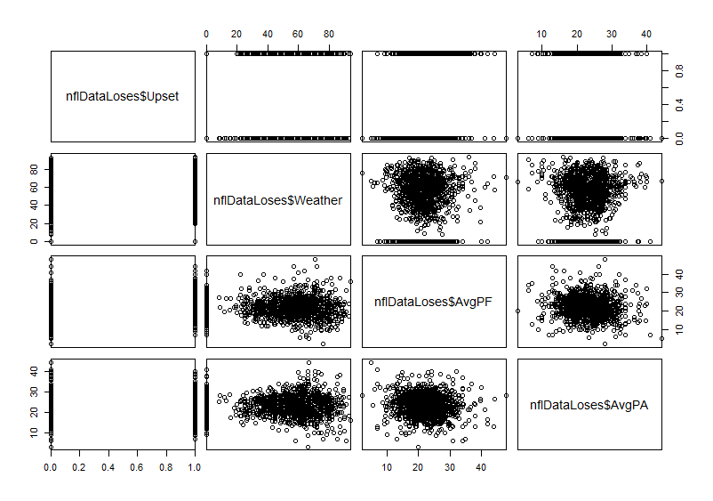
Results: Data Analysis (1 of 4)

Slide 8
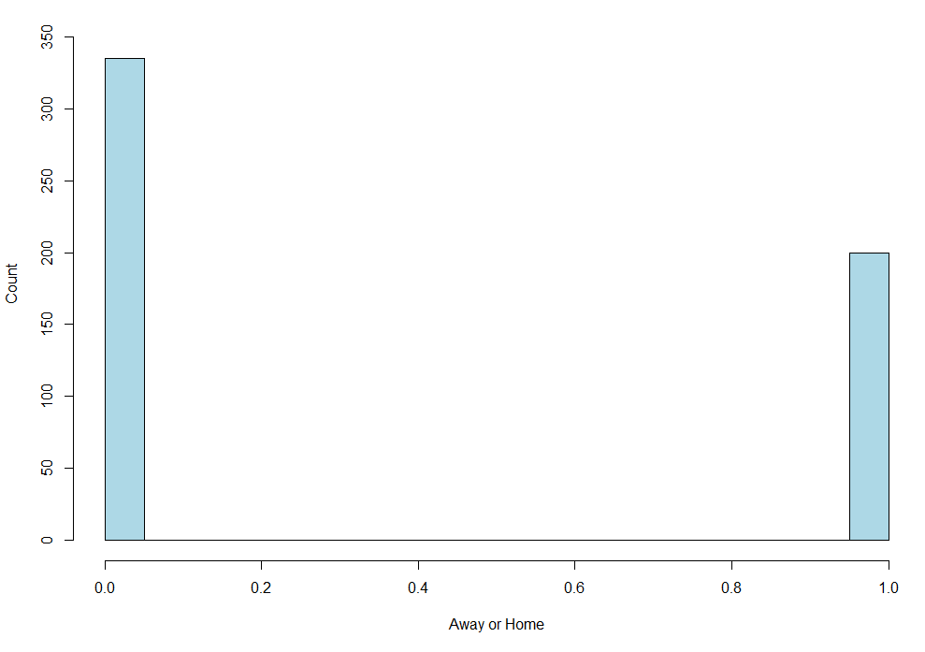
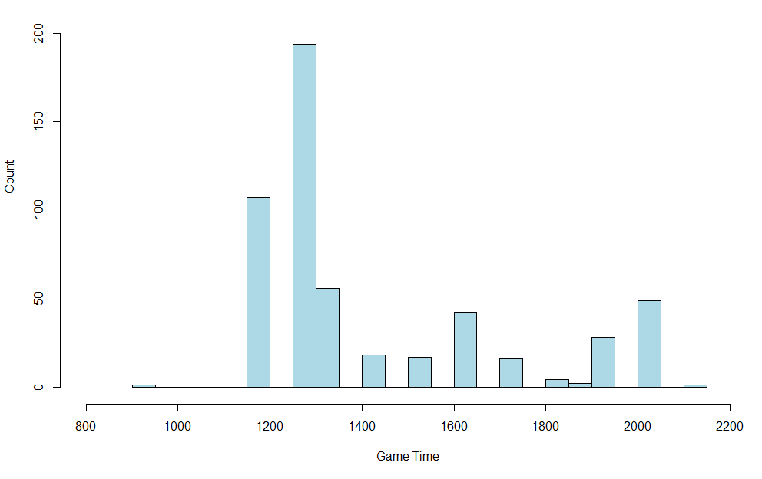
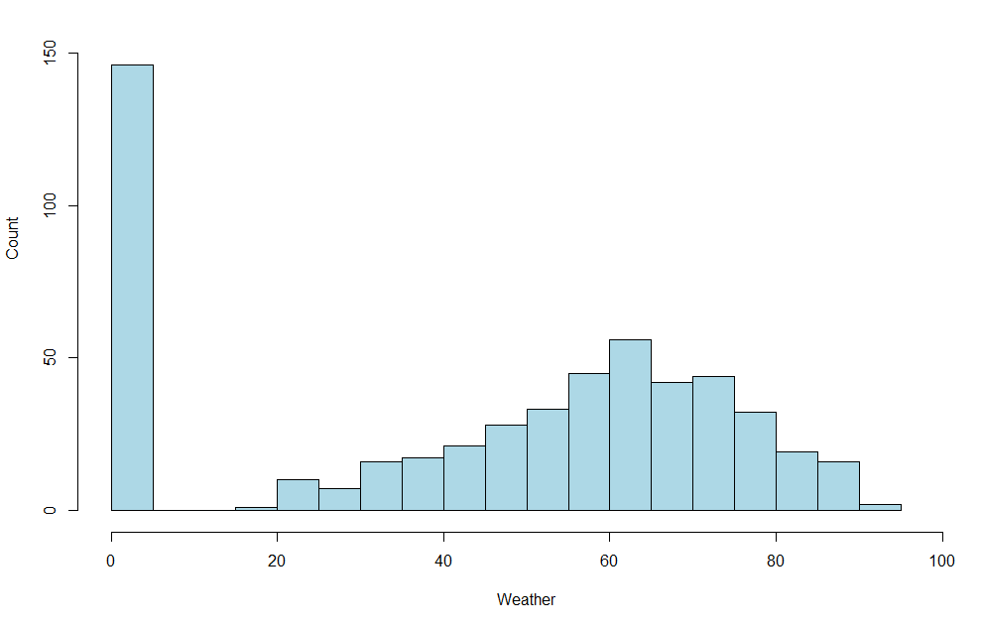
Results: Data Analysis (2 of 4)
Notes:
Left: Histogram of Upset Wins Weather
Middle: Histogram of Upset Wins Game Time
Right: Histogram of Upset Wins Away (0) or Home (1)

Slide 9
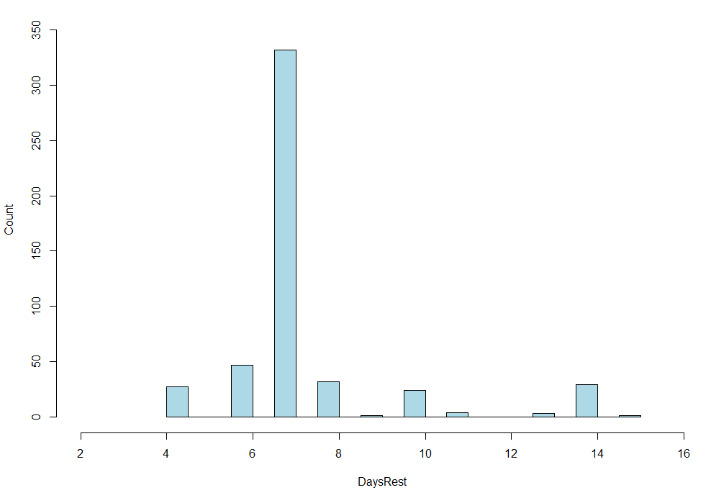
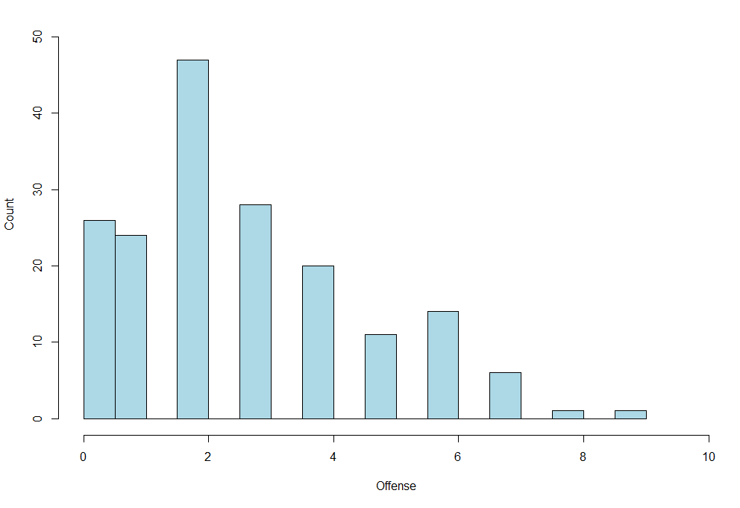
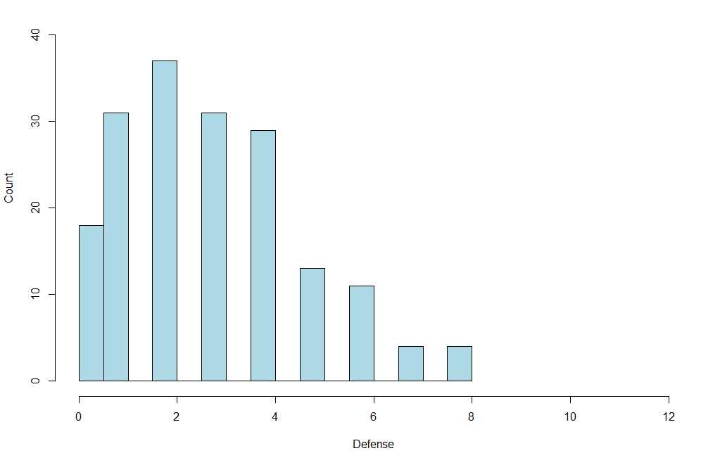
Results: Data Analysis (3 of 4)
Notes:
Left: Histogram of Upset Loses Days Rest
Middle: Histogram of Upset Loses Offensive Injuries
Right: Histogram of Upset Loses Defensive Injuries
Injuries->Game Time decisions

Slide 10
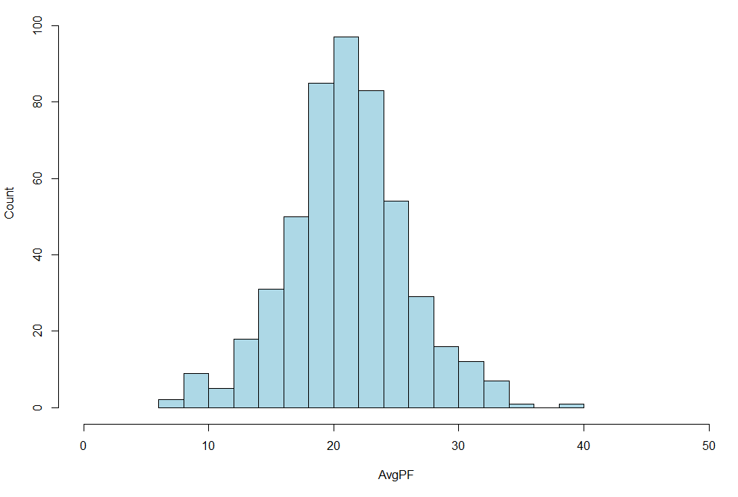
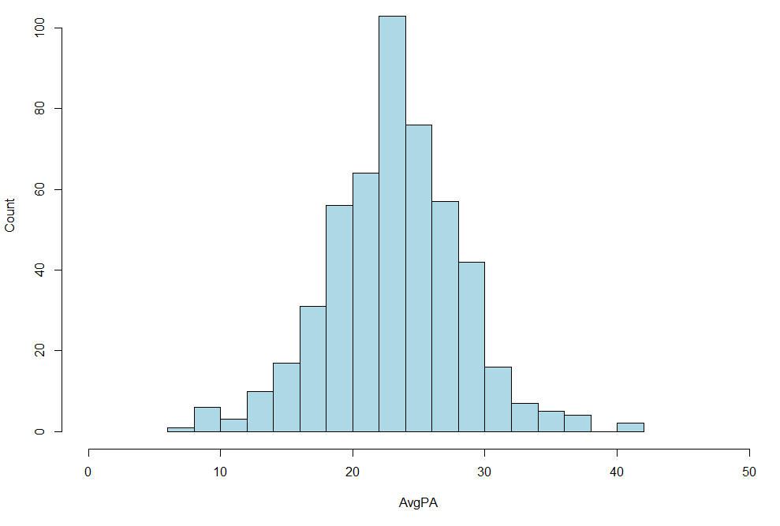
Results: Data Analysis (4 of 4)
Notes:
Left: Histogram of Upset Wins Average Points For
Right: Histogram of Upset Wins Average Points Against

Slide 11
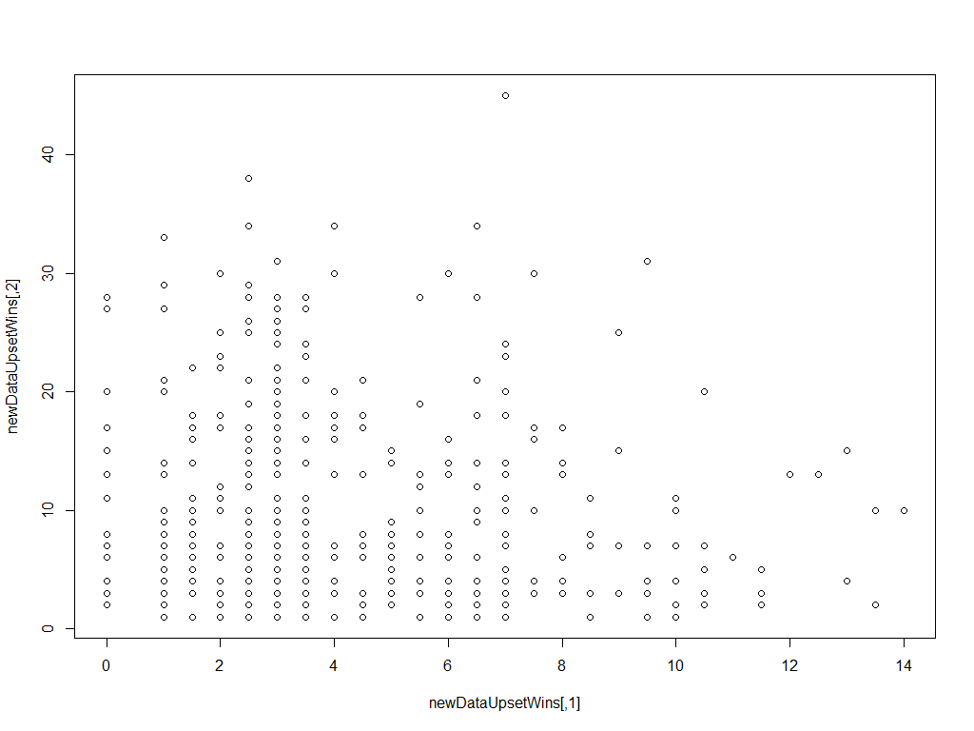
Results: Magnitude of Upset – Clustering
Notes:
Before any clustering algorithms … Odds vs UpsetAmt

Slide 12
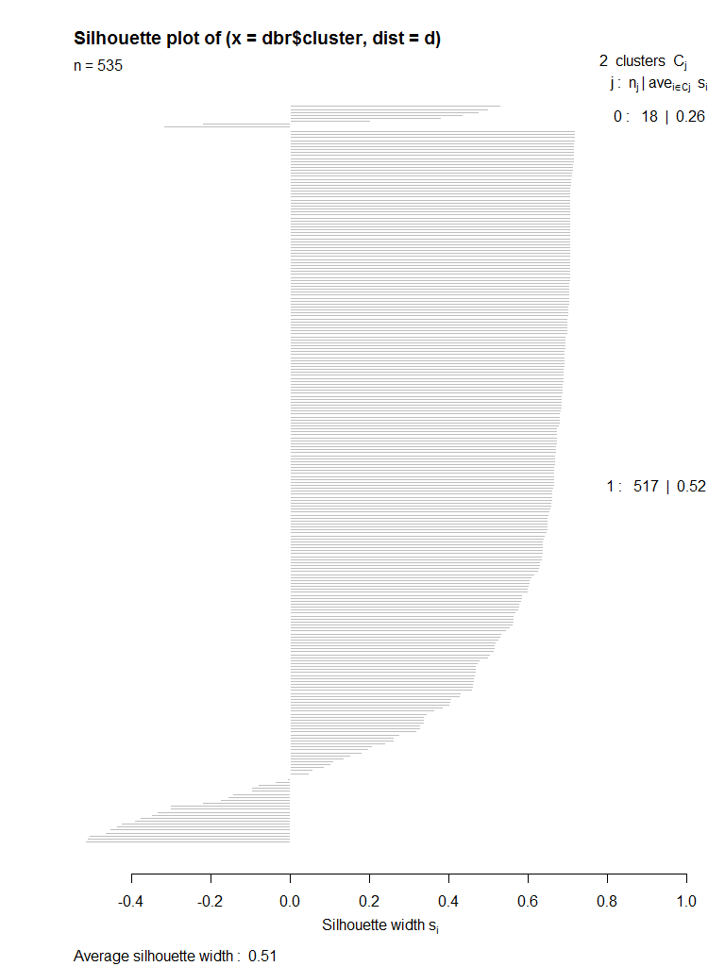
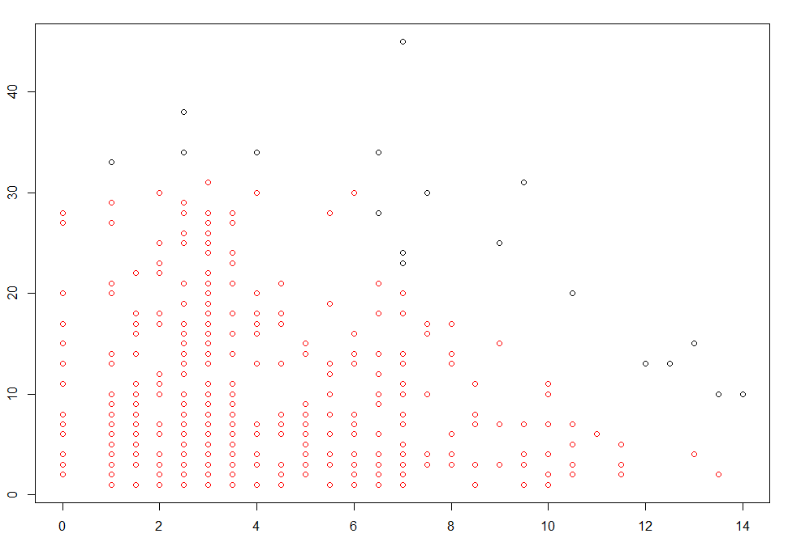
Results: Magnitude of Upset – Clustering with DBSCAN
Notes:
2 clusters … red and black
A few outliers

Slide 13
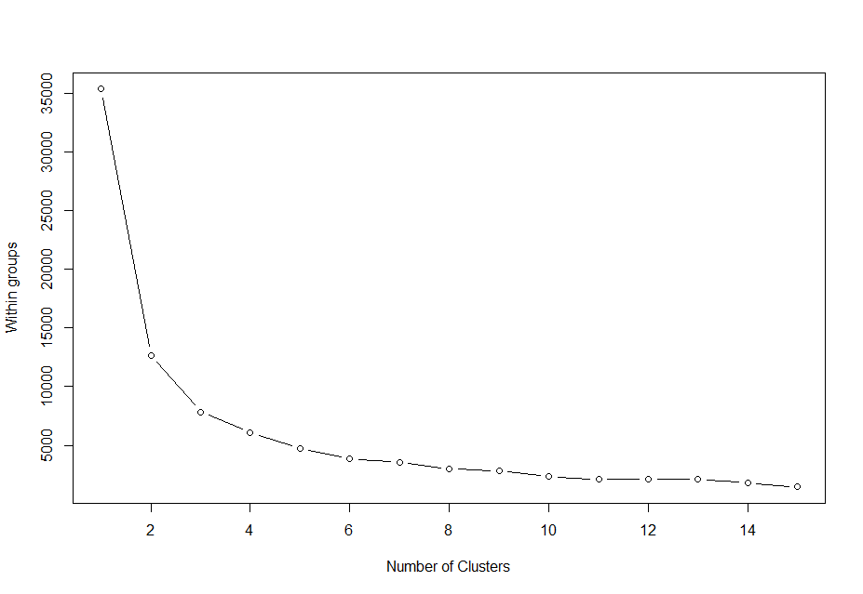
Results: Magnitude of Upset – Clustering with K-Means (1 of 4)

Slide 14
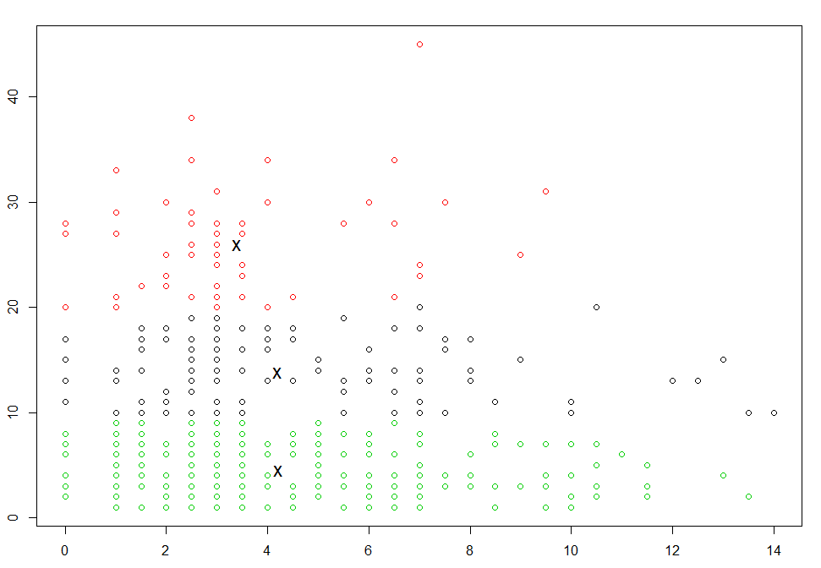
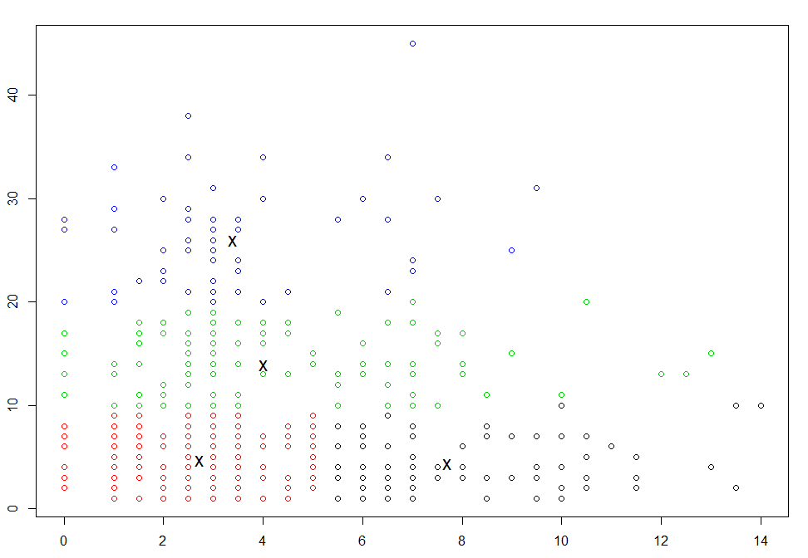
Results: Magnitude of Upset – Clustering with K-means (2 of 4)
K-Means Clustering k=3
K-Means Clustering k=4

Slide 15
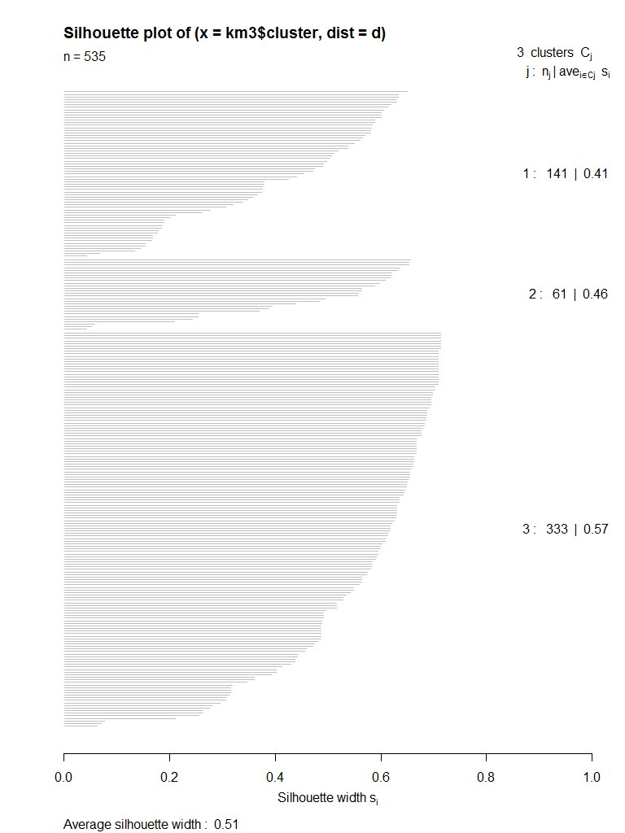
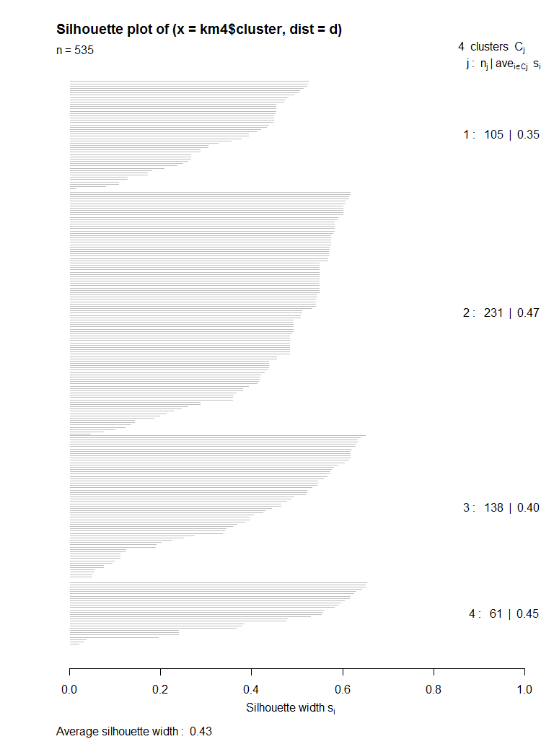
Results: Magnitude of Upset – Clustering with K-means (3 of 4)
K-Means Clustering k=3
K-Means Clustering k=4

Slide 16
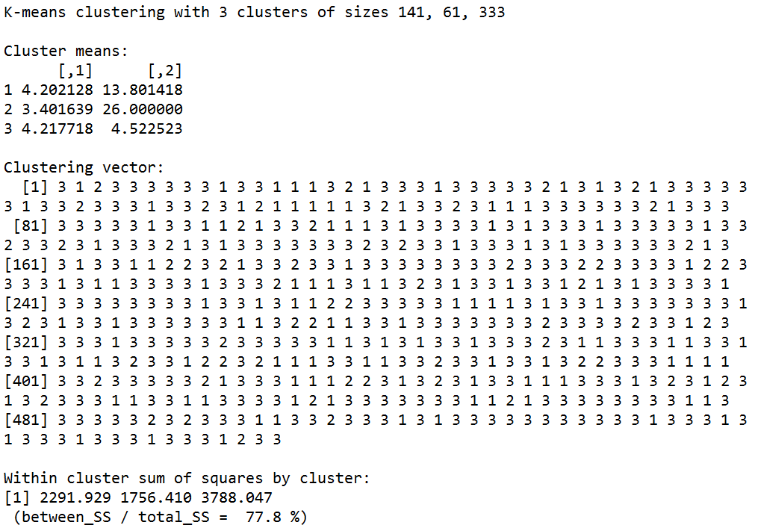
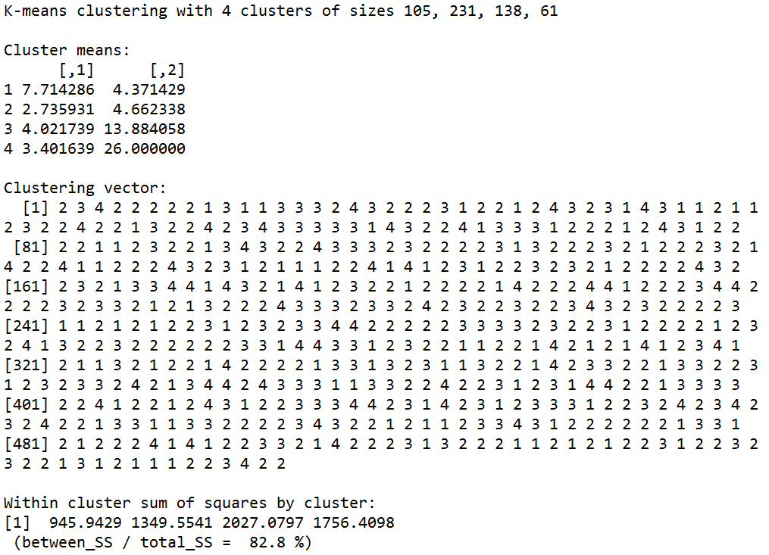
Results: Magnitude of Upset – Clustering with K-Means (4 of 4)
K-Means Clustering k=3
K-Means Clustering k=4

Slide 17
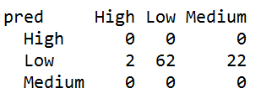
Results: Magnitude of Upset – Classification with Naïve Bayes
Naïve Bayes:
Classifier:
Upset Amount (UpsetAmt)
Parameters:
Away or Home (AorH)
Game Time (Time)
Game Weather (Weather)
Average Points For (AvgPF)
Average Points Against (AvgPA)

Slide 18
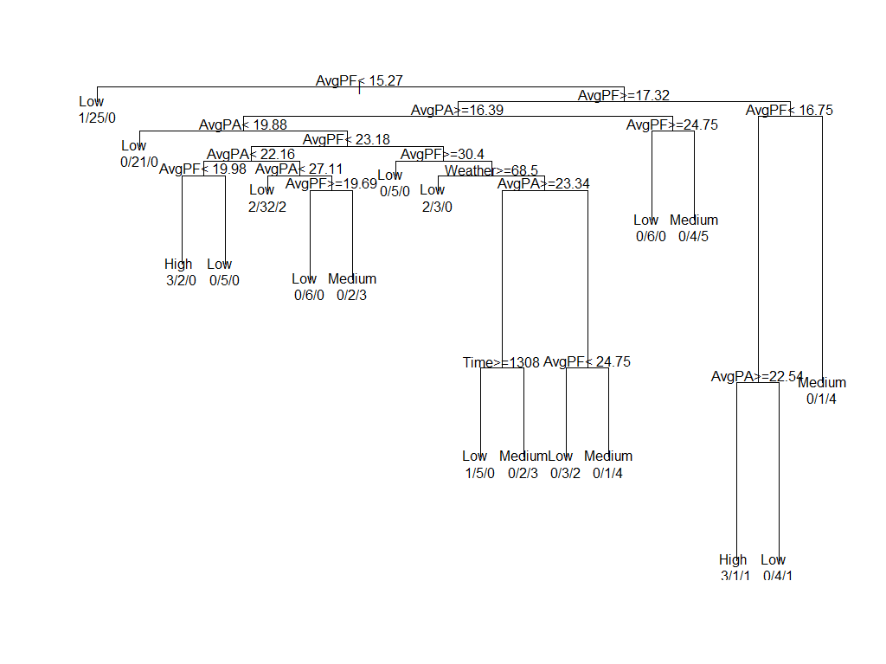
Results: Magnitude of Upset – Classification with Decision Tree (1 of 2)

Slide 19
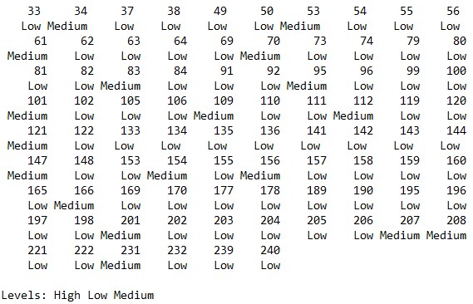
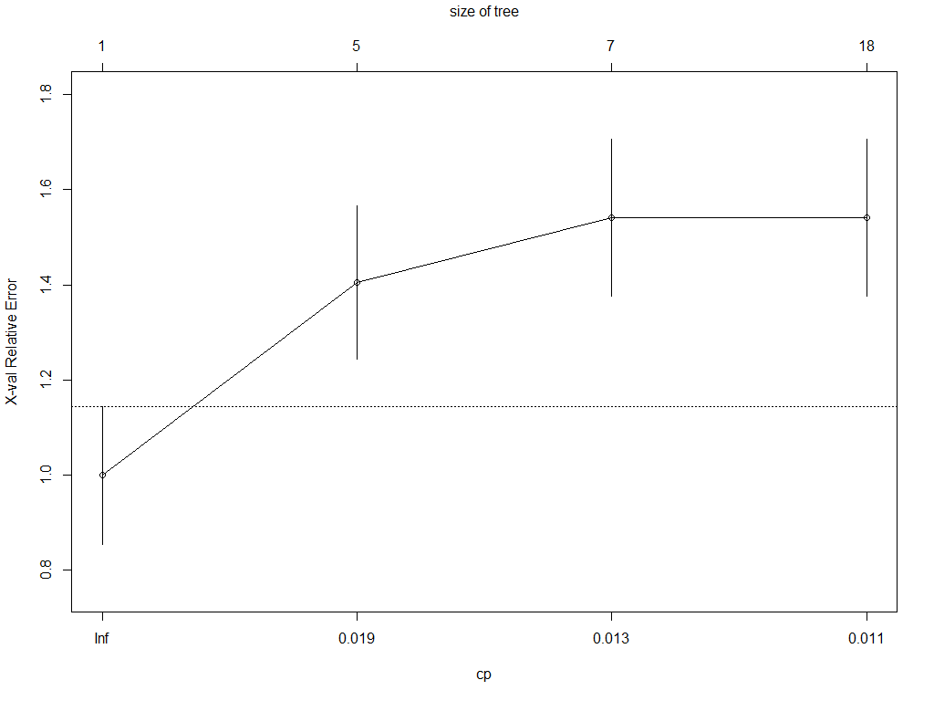

Results: Magnitude of Upset – Classification with Decision Tree (2 of 2)

Slide 21
Results: Upset by Years – Classification with Naïve Bayes
Naïve Bayes:
Classifier:
Upset Amount (UpsetAmt)
Parameters:
Away or Home (AorH)
Game Time (Time)
Game Weather (Weather)
Average Points For (AvgPF)
Average Points Against (AvgPA)
Spread (Odds)

Slide 22
Results: Upset by Years – Classification with Decision Tree (1 of 2)

Slide 23
Results: Upset by Years – Classification with Decision Tree (2 of 2)

Slide 24
Results: Upset 70/30 – Classification with Naïve Bayes
Naïve Bayes:
Classifier:
Upset Amount (UpsetAmt)
Parameters:
Away or Home (AorH)
Game Time (Time)
Game Weather (Weather)
Average Points For (AvgPF)
Average Points Against (AvgPA)
Spread (Odds)

Slide 25
Results: Upset 70/30 – Classification with Decision Tree (1 of 2)

Slide 26
Results: Upset 70/30 – Classification with Decision Tree (2 of 2)

Slide 27
Conclusion
<insert conclusions here>

Slide 28
Question
<insert here>

